Slide 1
Book Nerd, Meet Tech Geek
OER Improves Faculty Professional Learning
  Alyson Indrunas
  Director of eLearning & Instructional Design
  #WSHETC 2015 Building Bridges
Notes:
https://secure.flickr.com/photos/44124401501@N01/1138341328

Slide 2
Pejorative Slang Obsession
Nerd (adjective: nerdy)
  may spend inordinate amounts of time on unpopular, obscure, or non-mainstream activities, which are generally either highly technical or relating to topics of fiction or fantasy, to the exclusion of more mainstream activities
Geek (adjective: geeky)
  used to describe eccentric or non-mainstream people; in current use, the word typically connotes an expert or enthusiast or a person obsessed with a hobby or intellectual pursuit

Slide 3
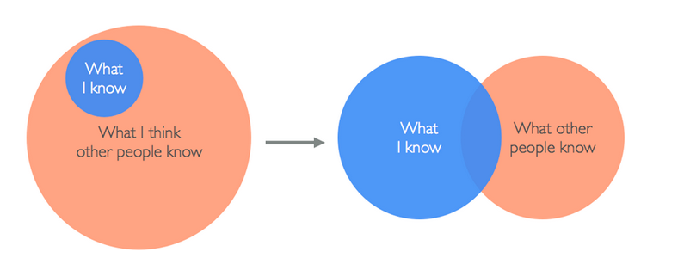
Impostor Syndrome Venn Diagram
Notes:
https://medium.com/@aliciatweet/overcoming-impostor-syndrome-bdae04e46ec5

Slide 4
Inspiration, Meet Epic Fail
Attend Assessment, Teaching, & Learning Conference.
Hear about Tacoma Community College $250k model. #YessyYesYes
Describe TCC model to superiors. Green Light!
Connect with TCC Geniuses.
Read all of their work. Heart races…

Slide 5
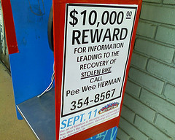
Motivation ala 1980s Philosopher
You don’t want to
get mixed up with a
guy like me.
I’m a loner, Dottie.
A rebel.

Slide 6
How do we____________?
Commitment: (She was 6 months old at the time).
Ask/Beg: (Are you there, OER Scholars? It’s Me, Alyson.)
Action Plan: Gather a cohort of go-getters.
(And the Academy Award for leadership goes to…)

Slide 7
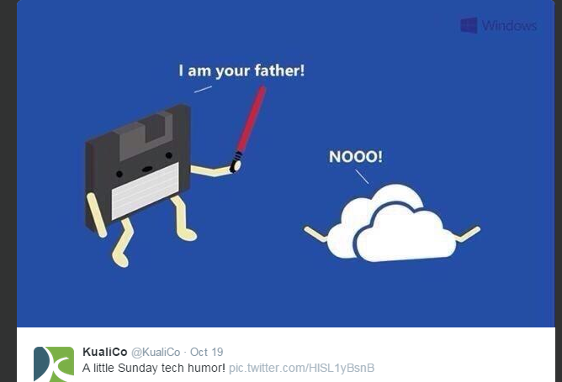
Unsexy Tasks of Leadership
Notes:
So what are the key differences? First, one combatted a visible and immediate problem...the other combated an invisible problem.
...a perfect example of an unsexy task: it demands painstaking effort without immediate reward.
Source: https://twitter.com/KualiCo/status/523976071201705984
...a perfect example of an unsexy task: it demands painstaking effort without immediate reward.
...a perfect example of an unsexy task: it demands painstaking effort without immediate reward.
...a perfect example of an unsexy task: it demands painstaking effort without immediate reward.

Slide 8
Identify Barriers
To create new norms, you have to understand people’s existing norms and barriers to change.
You have to understand what’s getting in their way...help them practice doing things differently.
#MentorsNeeded
Notes:
Guwande

Slide 9
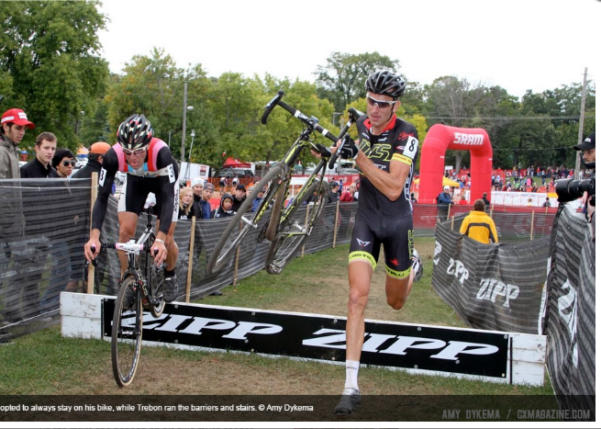
Getting Over The Barriers
Notes:
Photo credit. Amy Dykema. Jeremy Powers and Ryan Trebon

Slide 10
Embrace Chaos & Messiness
We want frictionless, “turnkey” solutions to major difficulties...We prefer instructional videos to teachers, drones to troops, incentives to institutions.
People and institutions can feel messy and anachronistic.
#Slow Ideas
Notes:
Guwande In the era of the iPhone, Facebook, and Twitter, we’ve become enamored of ideas that spread as effortlessly as ether.

Slide 11

Door-to-Door, Click-to-Click
…attacks the invisible problem in a way that is routinely dismissed as impractical and inefficient:
by going door-to-door, person by person, and just talking.
It’s our job to figure out the click to click.
Notes:
photo credit: <a href="http://www.flickr.com/photos/22083482@N03/4332342628">Moni Panagias Kantariotissa Kantara</a> via <a href="http://photopin.com">photopin</a> <a href="https://creativecommons.org/licenses/by/2.0/">(license)</a>

Slide 12
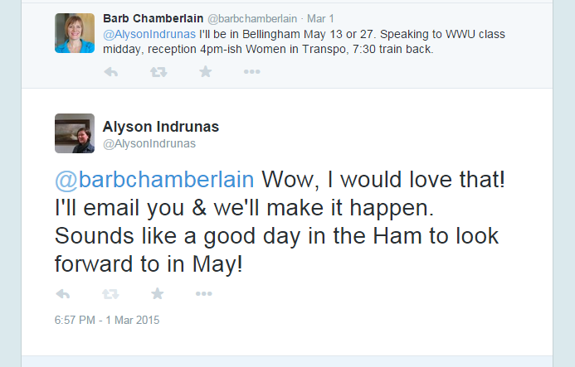
People Talking to People
  Diffusion is essentially a social process through which people talking to people spread innovation.
    ~Everett Rogers
Notes:
Guwande

Slide 13
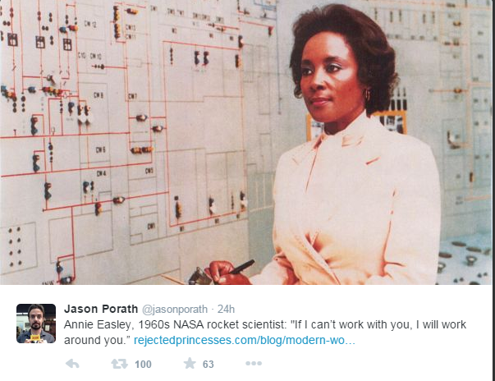
Working The Workaround
Annie Easeley, 1960s NASA rocket scientist:
“If I can’t work with you, I will work around you.”
Notes:
People talking to people is still how the world’s standards change.

Slide 14
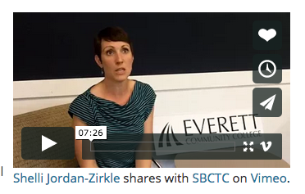
The Right People
Every change requires effort, and the decision to make that effort is a social process.
Notes:
Photo credit: Alyson Indrunas, emphasis on text mine

Slide 15
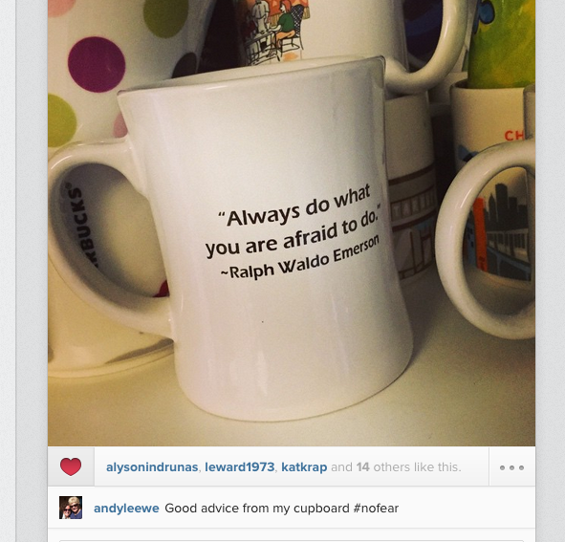
Fundamentals
Putting the
fun in fundamentals of faculty professional learning.
Patience.
Caring.
Listening.
Choice.

Slide 16

Dream, Meet My Reality Soon.
Time is wasted talking about the Red Lights.
Green Lights are ready to GO.
Yellow Lights:
Who are you and how can we help you GO?
Notes:
http://popchartlab.tumblr.com/post/35648129993/the-ur-venn-diagram-depicting-the-eternal-struggle

Slide 17
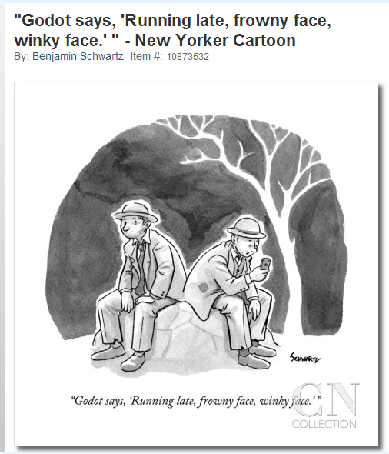
Technology Before People Fails
Let's go. Yes, let's go. (They do not move).
        Act I

Slide 18
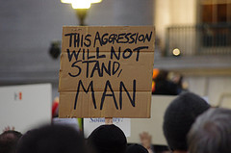
Faculty Are Busy
It’s our job to help them find the rug that ties the entire room together.

Slide 19
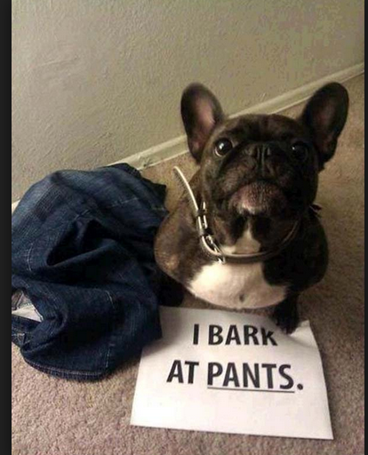
Quick Questions About Slow Ideas
What are the barriers at your institution?
What would you do if nobody would say no to your ideas?

